Slide 1

Retail online store sales project explained (Using Power BI)

Slide 2
Context
The dataset from the Online Super Store provides comprehensive insights into business sales data throughout the United States. This dataset is particularly valuable for understanding product purchases, sales, and profits by region, state and city. It plays a crucial role in assessing business performance and identifying areas for improvement, which is vital for defining future goals, shaping marketing strategies, and enhancing overall customer experience. Covering a diverse range of purchase item data, including profit margins and payment methods, this dataset enables businesses to make informed decisions about their performance and pinpoint areas that require enhancement through detailed analysis.

Slide 3
Order ID Dataset includes following columns :
Row# | Payment Mode | Returns
Order Date | customer name | Product ID
Order ID | Segment | Category
Ship date | Country | Sub-Category
Ship mode | State | Profit
Ship Date | City | Sales
Customer ID | Region | Quantity

Slide 4
Project Overview
Dashboard Creation:
Identify of the KPIs, design on intuitive and visually appealing dashboard. Add interactive, visualization and filtering capabilities to allow users to explore data at various level of gratitude.
Data Analysis:
Utilize Power Query for the data analysis phase to cleanse and analyze data using the DAX (Data Analysis Expressions) language.
Sales Forecasting :
Leverage historic data and apply time series analysis to generate sales forecast for next 15 days.
Actionable insight and recommendation:
End goal is to provide insight and valuable information that can drive strategic decision to support the supermarket’s goals for growth, efficiency, satisfaction.

Slide 5
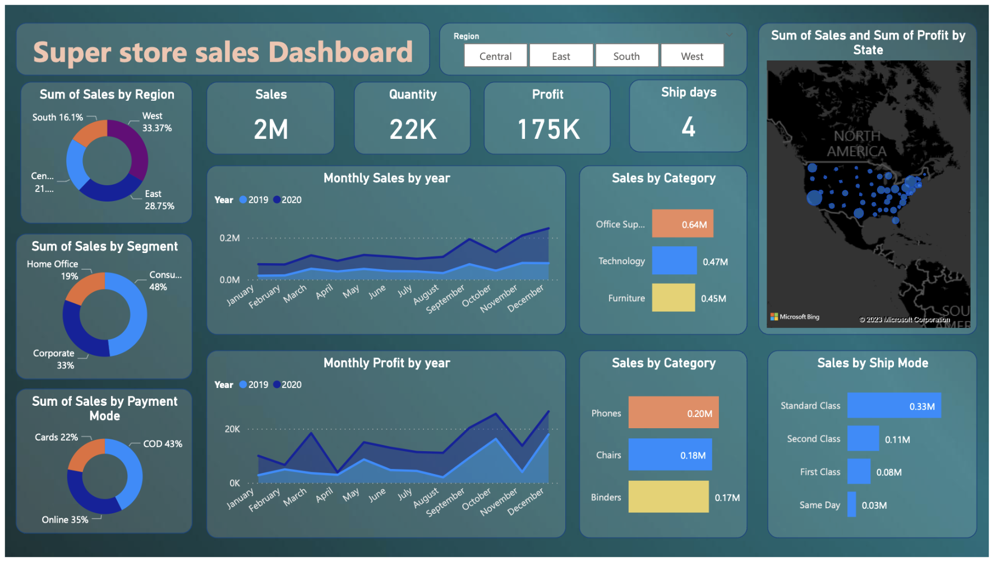

Slide 6
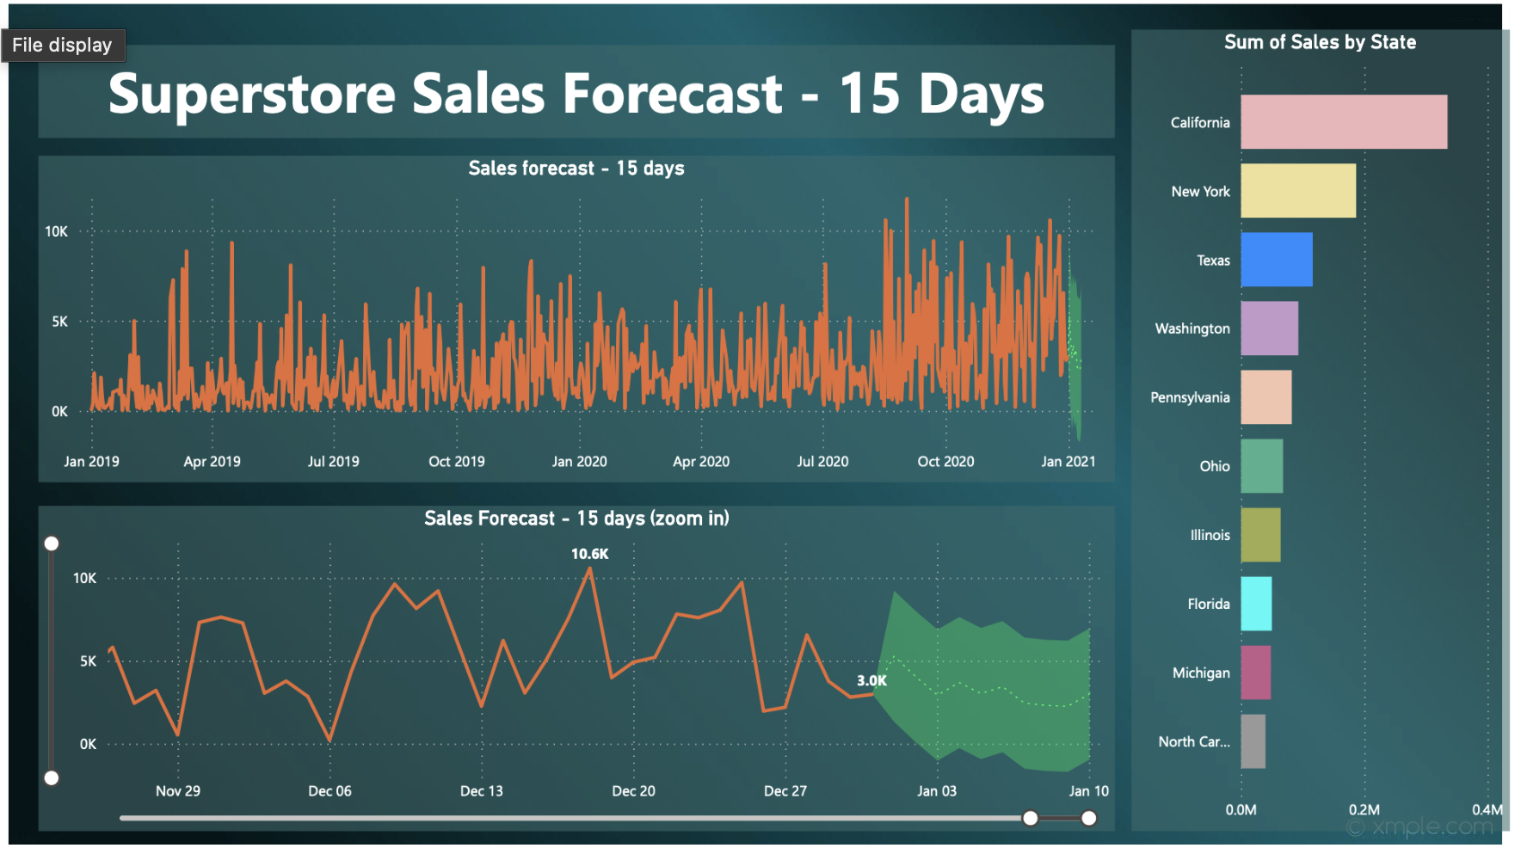

Slide 7
Insights

Slide 8
Highlights of Sales In year 2019 and 2020
Total Sales : 2 million total Sales
Product sold : 22k
Profit : 175k
Average shipping day – 4 days
December 2020: Sales peak at $166,185.85, 8% of $2M total sales.
March 2020: $14,751.89 profit, 8% of $175k investment.

Slide 9
Glimpse of the dashboard
The West region experienced the highest sales, accounting for 33.37% of total sales, while the lowest sales were recorded in the South, constituting 16.1% of the total.
Consumer sales led with the highest share at 48% of the total, followed by corporate and home office sales.
Cash on delivery was the most utilized payment method, with card payments registering the least.
Office supplies emerged as the top-selling category for the 2019-2020 sales period.
Phones were the most popular item, contributing 0.2 million to the total revenue.
The preferred shipping mode among customers was 'standard class.'

Slide 10
Recommendation

Slide 11
Recommendation
Regional Focus: Given the significant difference in sales between the West and South regions, consider implementing targeted marketing strategies in the South to boost sales and market presence.
Sales Strategy: Since consumer sales dominate, focus on tailoring sales strategies to cater to consumer preferences. Consider special promotions, discounts, or loyalty programs to further engage this segment.
Payment Method Optimization: Given the popularity of Cash on Delivery, ensure that this payment method is streamlined and convenient for customers. Additionally, explore ways to incentivize other payment methods to increase their usage.
Category Emphasis: Given that office supplies are the top-selling category, consider expanding the product range or implementing promotions within this category to capitalize on its popularity.

Slide 12
Recommendation
Product Mix: Since phones are the most popular item contributing significantly to revenue, consider introducing new phone models or related accessories to capitalize on this demand and potentially increase revenue further.
Shipping Experience: Continue to prioritize the 'standard class' shipping mode as it appears to be the preferred choice among customers. Ensure that the shipping process is efficient and meets customer expectations to enhance overall satisfaction.
Market Segmentation: Analyze customer demographics and preferences in California, New York, and Texas. Tailor marketing campaigns and product offerings to align with the unique characteristics of each state, maximizing the impact of regional sales strategies.
Supply Chain Optimization: Given the high sales in California, New York, and Texas, optimize the supply chain to ensure efficient and timely delivery of products to meet the demand in these leading states. Consider local partnerships or distribution centers to streamline operations.

